Slide 1

Healthy & Tasty Food Store

Slide 2
Team Members
Mohamed Moustafa
Zinab Mohamed
Mona Hamed
Hoda Hamed

Slide 3
Suppliers of food and intermediate products.
vitagrove
VitaGrove Team
9/2024
1
Suppliers of food and intermediate products.
Production of healthy meals, drinks, juices, snacks.
And marketing it through social medial platforms , websites & Talabat App
Providing customers with healthy meals, drinks, juices & snacks.
Meeting the needs of customers looking for healthy and natural food
Diversity of products
strong relationships with customers by providing high-quality products, excellent customer service, and loyalty programs.
-conscious individuals, families, athletes, people looking for quick and healthy meals.
Raw materials (e.g., fresh fruits and vegetables), technology (production and packaging equipment), staff (production workers, marketing team).
Online sales through a website & social media platforms plus delivery by TALABAT company
raw materials, production costs, online marketing and distribution costs, staff costs, with a total budget of 1000,000 L.E
Eat Good, Abu Auf, Organic Nation & Lychee
product sales to customers online and through delivery.

Slide 4
SWOT ANALYSIS
S Free consultation for Coaches and Physical Education Teachers Cross platform easy navigation website The team members are young and enthusiastic Easy delivery with Talabat Application healthy product and at the same time tasty Competitive prices compared to competitors Experienced social media team | W Low brand awareness Low marketing budget Low social media pages awareness Many competitive companies
O Growing market Health awareness Gym& sports interests increasing healthy aesthetic Lifestyle Multiple competitors support market awareness Local products in the current boycott. | T Inflation Well-known/established competitors competitors strong competitive Global wars and disorders

Slide 5
Financial objectives for the first year
VitaGrove target to sell the following amount of each product category monthly at the first year quarter (in units)
And we will work hardly to increase this sales amount by 15% every year quarter
Product | Herbal Tea | Chocolate bar | chocolate cake | Juice | Noodles | cookies
Units | 3500 | 1000 | 2000 | 3000 | 2000 | 2000
Value (LE) | 59500 | 55000 | 140000 | 105000 | 50000 | 200000
Total sales 609500 LE

Slide 6
Marketing objectives for the first year
Reach more than 200000 Facebook customers per month through Ads. , organic content & enhancing SEO for social platforms, plus increasing followers by 5-10% each year quarter
Increase YouTube channel subscribers by 10% every month & increasing total watching time
Reach 1000 follower at least every year quarter on Instagram
Increase engagement by 5-10% on all marketing sites each year quarter

Slide 7
Target Segments
We target young adults and mid age parents who:
Has Interest in sports, fitness and yoga
People with weight goals
Mothers with children and teenagers
People with chronic diseases (diabetes, high pressure, etc)
Club Coaches
Physical Education Teachers

Slide 8
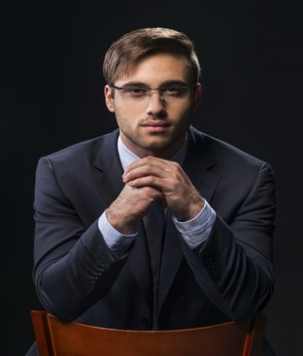
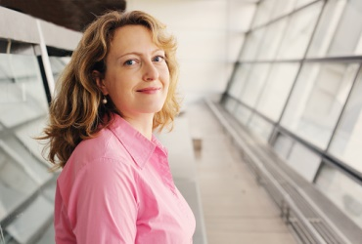
Buyer persona
Sohaila Age: 37 Education level: High Job: Fitness coach Alexandria Married with kids Interest: yoga, cooking, history, fashion, climate change, travel Goal: keep fit Needs: to be more fit and balance diet Challenges: quality/availability/diversity | Karem Age: 38 Education level: High Job: engineer Cairo Single Interest: scuba diving, blogging, social events, reading, gardening. Goal: bulking/gym goals Needs: balance diet, high portion package. Challenges: diversity/ meal prepping, good taste.

Slide 9
Competitive Advantage
Product Diversity: salty and sweet packaged Foods, Beverage, snacks and Complete Meals
Tasty, delicious and healthy products
Easy and fast delivery
prices matches other competitors in market

Slide 10
4 Ps – Marketing Mix
Product
Natural and organic food without any genetic modification or hormones with delicious taste
Price
VitaGrove present price matches other market competitors
Place
VitaGrove products available online through social media and websites and through quick delivery Talabat Application
Promotions
VitaGrove use social medial ads. & website technics to increase awareness of it’s products and support sales

Slide 11
4 Ps – Marketing Mix
Product
Natural and organic food without any genetic modification or hormones
balance between presenting healthy & organic products and delicious taste
Vitagrove products are assorted to satisfy all customers needs and wants so it contains herbal tea, Chocolate Bar, Chocolate Cake, Juice, Noodles & Cookies

Slide 12
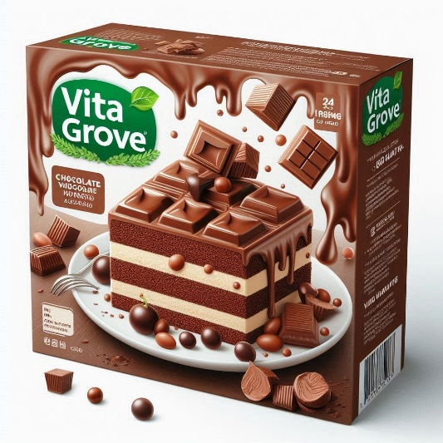

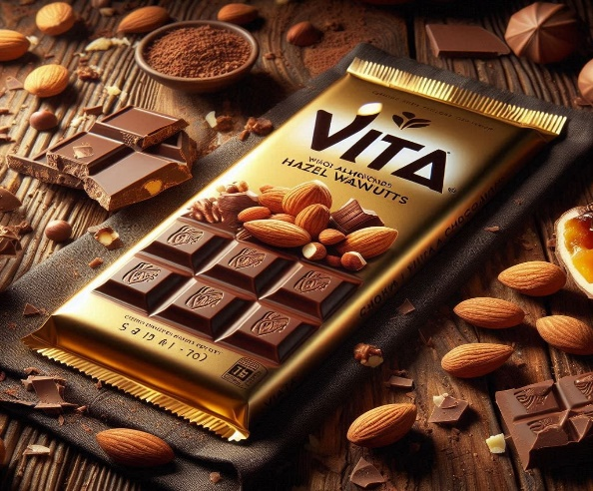

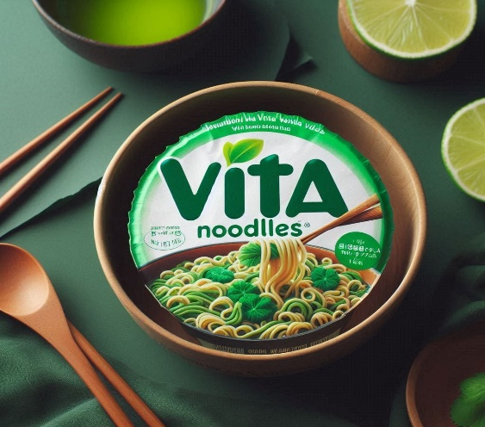
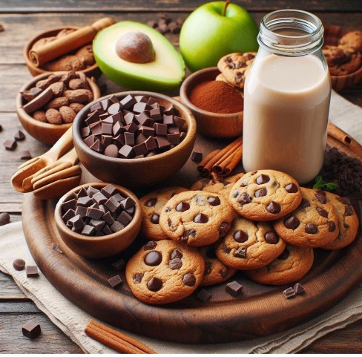
Our Collection
VitaGrove tea 17 LE
Vitagrove chocolate Protein Bar 55 LE
Chocolate cake mix 70 LE
Vitagrove juice 35 LE.
Vitagrove noodles 25 LE
cookies 100 LE

Slide 13
4 Ps – Marketing Mix
Price
Vitagrove present it’s products with matches other competitors price

Slide 14
4 Ps – Marketing Mix
Place
Vitagrove products are available online through it’s website & social media platform specially Facebook, Integra & Youtube
Customers also can get our products through Talabat Application

Slide 15
4 Ps – Marketing Mix
Promotion
Vitagrove products are available online through it’s technical use of website & social media features specially facebook, Instagram & Youtube plus using ads
Also we use email messages & Mobile SMS to market to our potential customers as coaches & Physical Education Teachers

Slide 16
Marketing channels
Facebook
2 posts weekly at 6:55 pm.
Educational content, using articles, videos, and images.
Friendly, Encouraging, and Positive tone.
Instagram
4 posts weekly at 9:50.
Educational content and branding using photos and infographic.
Friendly, Encouraging, and Positive tone.
YouTube
One video weekly every Friday at 7:50 pm.
Funny humorous and Educational content using video's and shorts.
Friendly and funny tone

Slide 17
calendar of social media platform
 | item | who | when | How many | cost | objectives
1 | Facebook | Mohammed | October to December 2024 | 2 posts weekly | free to 500 LE | to get 1000 followers
2 | Instagram | Zeinab | October to December 2024 | 4 posts weekly | free | to get 1000 followers
3 | YouTube | Hoda Hamed | October to December 2024 | One video weekly | 1000 LE | to get 5000 views and 300 subscription
4 | Videos | Mohammed | October to December 2024 | Creating videos to be attached to posts and ads | free to 500 LE | To be short and attracted
5 | Ads | Hoda Hamed | October to December 2024 | Creating ad on facebook , instagram and youtube | 1500 LE | Get affordable awareness and call to action to our website and social platforms
6 | Customer relation | mona | October to December 2024 | Replying to our customer comments and emails | free | To respond to customer comments or emails through 5-30 minutes as maximum time

Slide 18
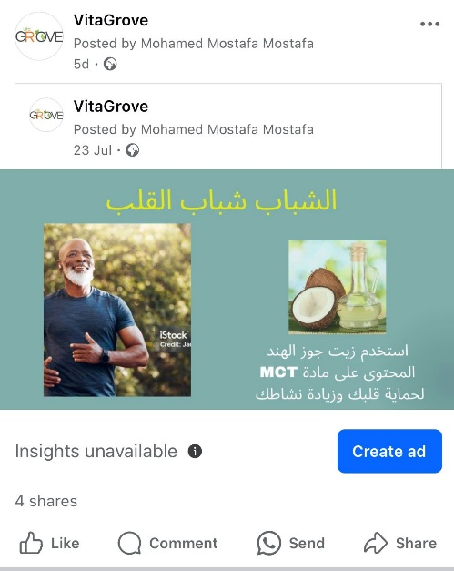
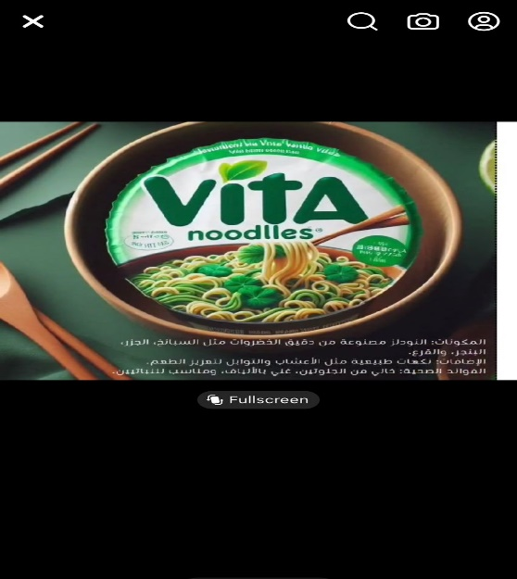
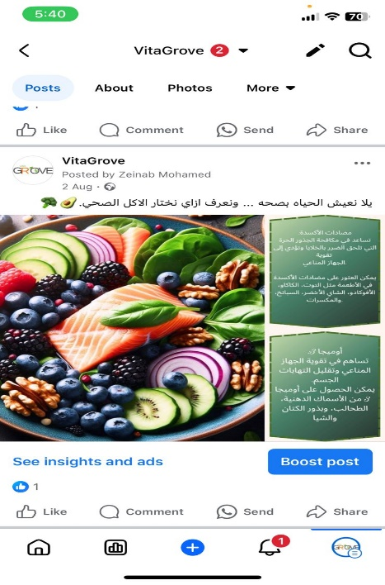
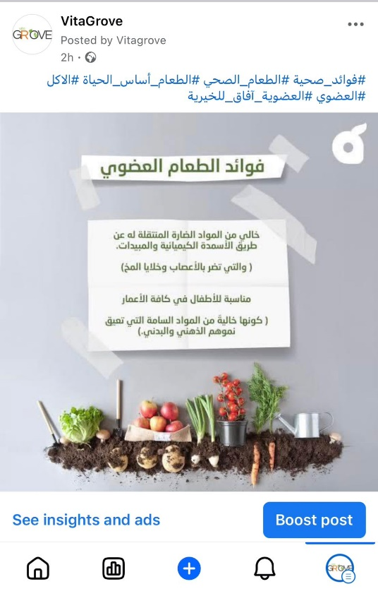
ACTION – What Is The Plan? Facebook
https://www.facebook.com/vitagrove.eg

Slide 19
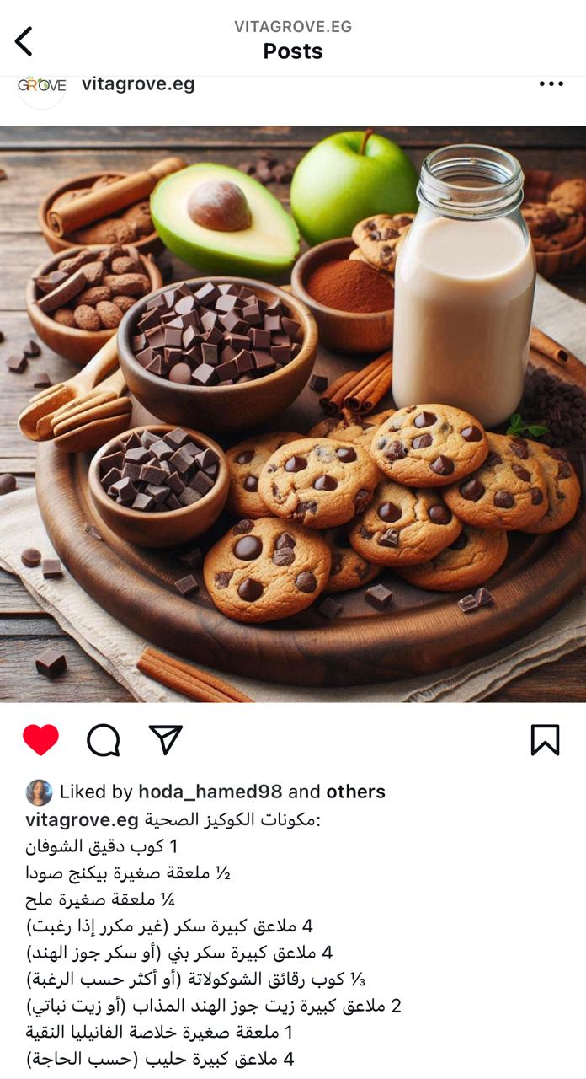
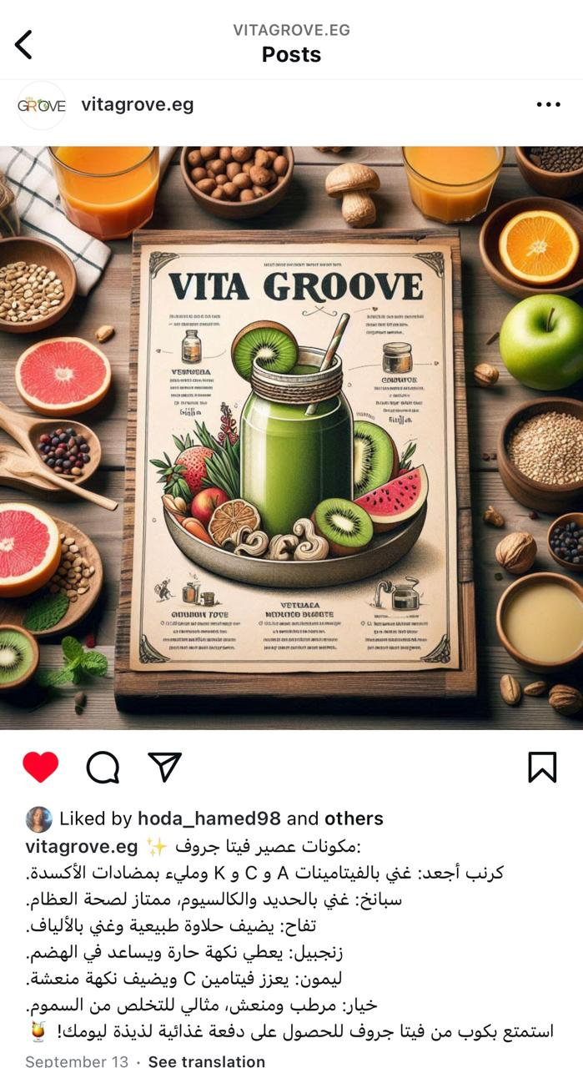
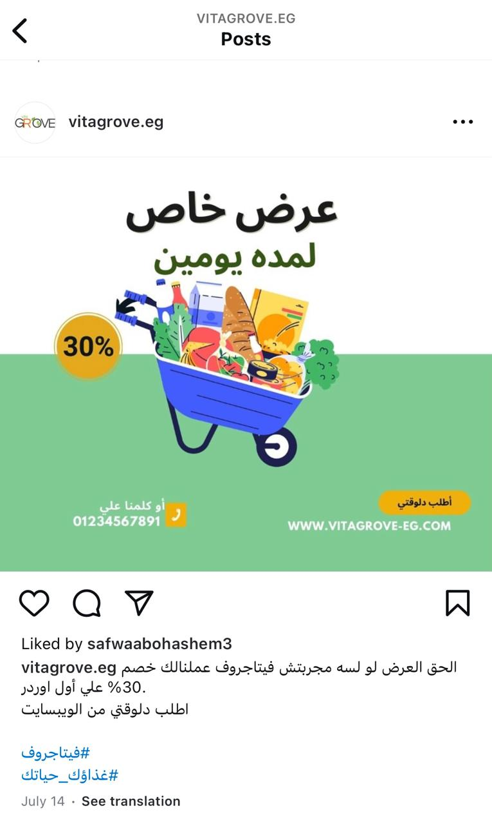
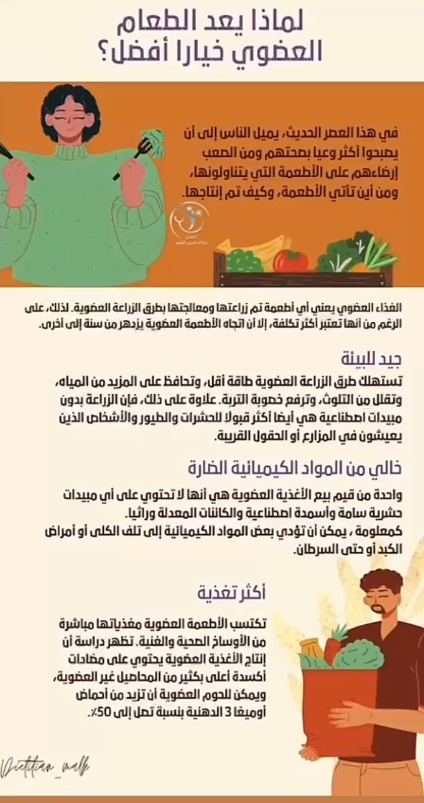
Instagram
Link 🔗:https://www.instagram.com/vitagrove.eg/?igsh=MWFyMnJ2dDhrYjNtNQ%3D%3D&utm_source=qr

Slide 20
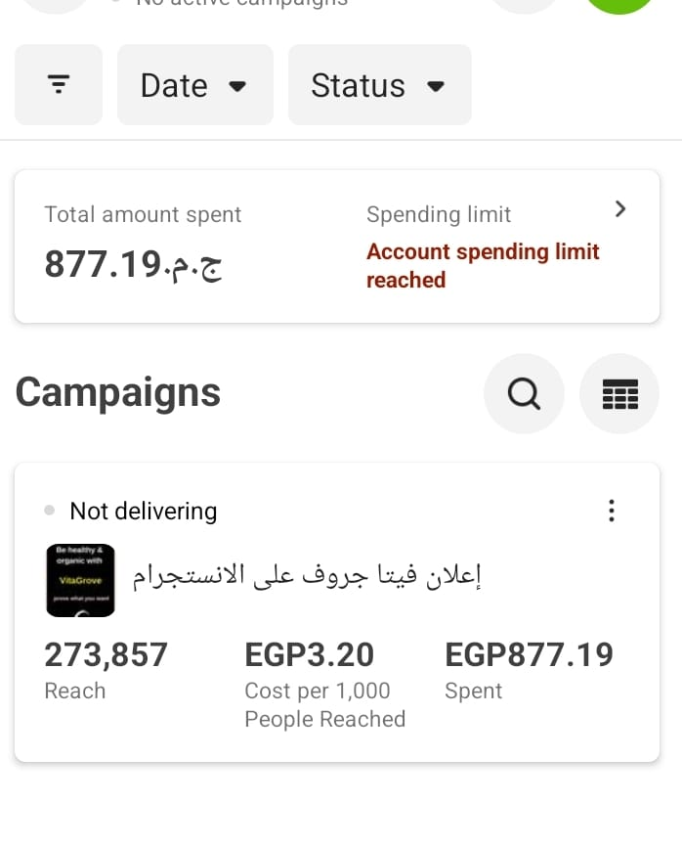
Advertising Campaign
We have created Ad. at Facebook platform to be published on Facebook and Instagram
The Ad. target was “ Awareness “ to reach more and more of our potential customers and increase our brand awareness
Ad. run for 6 days and get good results as shown on the following figure

Slide 21
KPI (key performance Indicators
To monitor our previously planned objectives on marketing channels we will use some of KPIs (Key Performance Indicators) during period from October to December 2024 as follow:
Facebook
4000 Page Impression | 100 comments monthly | 1000 Followers quarterly
Instagram
6000 Page Impression | 100 comments monthly | 1000 Followers quarterly
Youtube
600 Videos Impression | 50 comments monthly | 300/5000 subscribers / views time quarterly

Slide 22
Recommendations
We will determine:
According to all previous stages of studying and collecting information we will choose the most powerful solutions that will solve any problem we face as:
We will focus on Facebook & Instagram as successful platform with high rate of engagement & followers
Also we will increase Ads. on social media and Google Ads to reach quickly to more of potential customers
For products we will focus on Juice, protein bars & Snacks because it’s high sales rate
Plus producing new products we know from our customers comments on social media

Slide 23
Thank you for your attention

